Slide 1
Credit Card Lead Prediction
Supervised machine learning : Classification algorithm
Girish Vankudre

Slide 2
Problem statement
Happy Customer Bank is a mid-sized private bank that deals in all kinds of banking products, like Savings accounts, Current accounts, investment products, credit products, among other offerings.
The bank also cross-sells products to its existing customers and to do so they use different kinds of communication like tele-calling, e-mails, recommendations on net banking, mobile banking, etc.
In this case, the Happy Customer Bank wants to cross sell its credit cards to its existing customers. The bank has identified a set of customers that are eligible for taking these credit cards.
Now, the bank is looking for your help in identifying customers that could show higher intent towards a recommended credit card, given:
Customer details (gender, age, region etc.)
Details of his/her relationship with the bank (Channel_Code,Vintage, 'Avg_Asset_Value etc.)

Slide 3
Dataset and Data dictionary (List of features available for analysis and prediction)
Variable | Definition
ID | Unique Identifier for a row
Gender | Gender of the Customer
Age | Age of the Customer (in Years)
Region_Code | Code of the Region for the customers
Occupation | Occupation Type for the customer
Channel_Code | Acquisition Channel Code for the Customer (Encoded)
Vintage | Vintage for the Customer (In Months)
Credit_Product | If the Customer has any active credit product (Home loan, Personal loan, Credit Card etc.)
Avg_Account_Balance | Average Account Balance for the Customer in last 12 Months
Is_Active | If the Customer is Active in last 3 Months
Is_Lead(Target) | If the Customer is interested for the Credit Card 0 : Customer is not interested 1 : Customer is interested

Slide 4
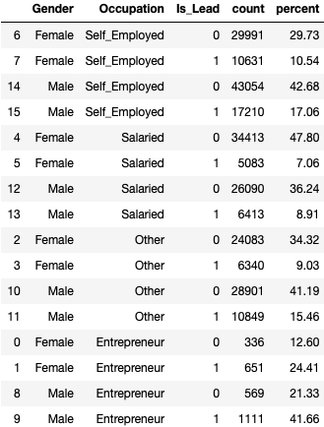
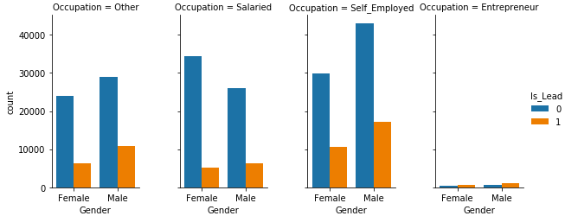
Exploratory Data Analysis - Relation between Gender, Occupation with distribution For ‘Is_Lead’
The Entrepreneur category is either least reported in the data or the Happy Customer Bank is not tapping potential of the category. For rest other category, even though count reported is good in terms of customer base, its ratio of turning into interest in Credit Card business does not seem to be great.
A suggestion would be bring Entrepreneur category into the ambit as well as target Fixed Salaried/Self Employed category of customer base.

Slide 5
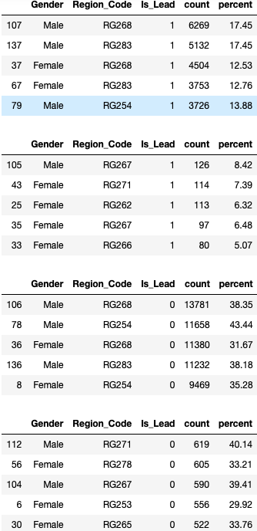
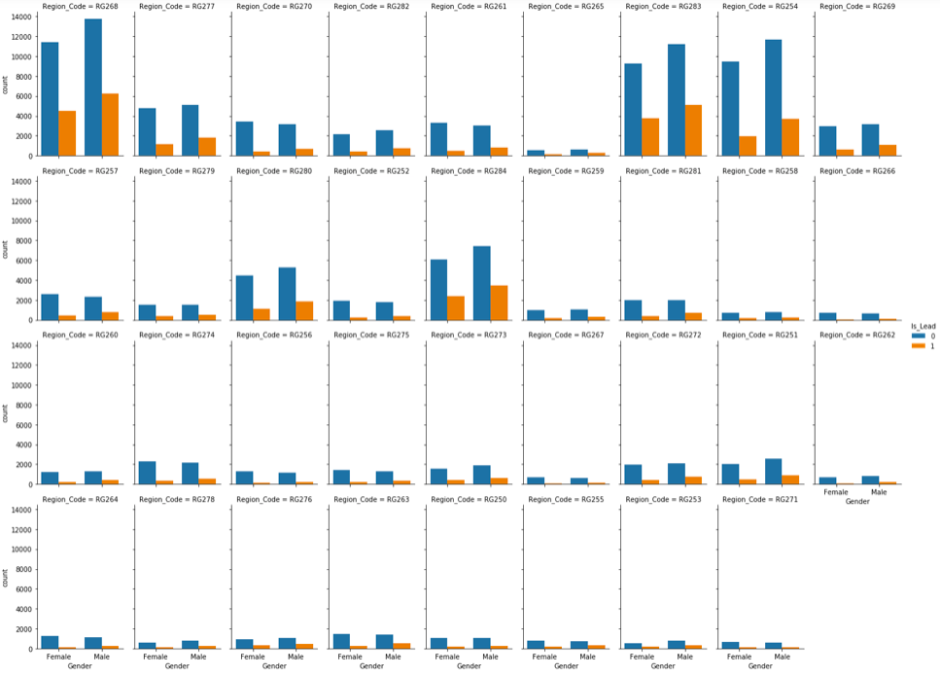
Exploratory Data Analysis - Relation between Gender, region_code with distribution For ‘Is_Lead’
Region wise Happy Customer Bank need to target Region with low 'Is_Lead = 1' count. At the same time target also need to set to convert Region with high 'Is_Lead = 0'.
Compared to Region_Code like RG268, RG283, RG254 rest all regions show poor customer base. A review of marketing campaign needs to be undertaken to tap the potential.

Slide 6
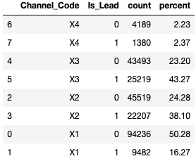
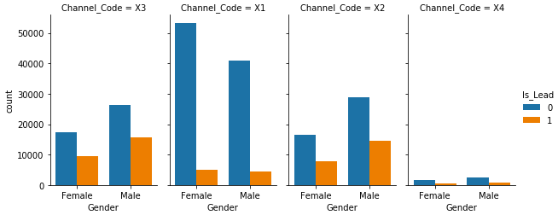
Exploratory Data Analysis - Relation between Gender, Channel_code with distribution For ‘Is_Lead’
The channel code X4 needs to be reviewed for better reach to customer base. Channel Code X1 even though high in total count, the interest of customers in Credit Card seems low both with Male and Female genders.
Channel code X3 seems doing fairly in terms of making people interested in Credit Card business.

Slide 7
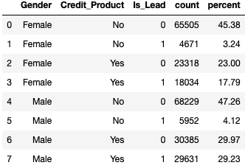
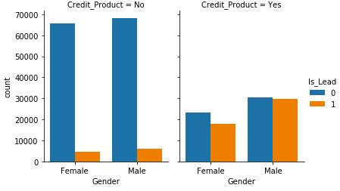
Exploratory Data Analysis - Relation between Gender, Credit_Product with distribution For ‘Is_Lead’
Other than Credit Card, there is ample opportunity available where customers can be targeted for different credit products. Looking at Credit_Product entitlement there seems fairly equal chance that a customer is also interested in Credit Card.

Slide 8
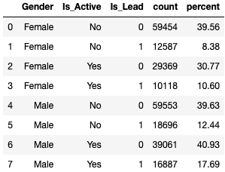
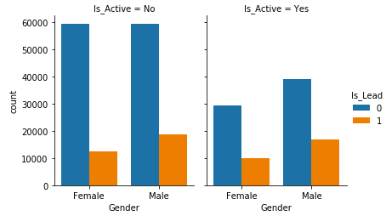
Exploratory Data Analysis - Relation between Gender, Is_Active with distribution For ‘Is_Lead’
Customer Activity seems to have some effect on balancing out the interest ratio for Credit Card business but there is a higher number of customer base which is inactive. The Happy Customer Bank need to take up engagement programs to ensure that such customer base does transact with different credit products that the bank offers.

Slide 9
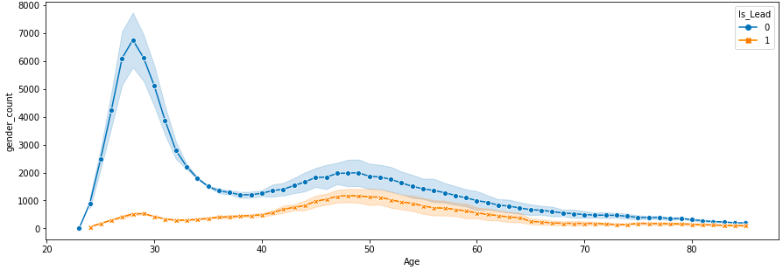
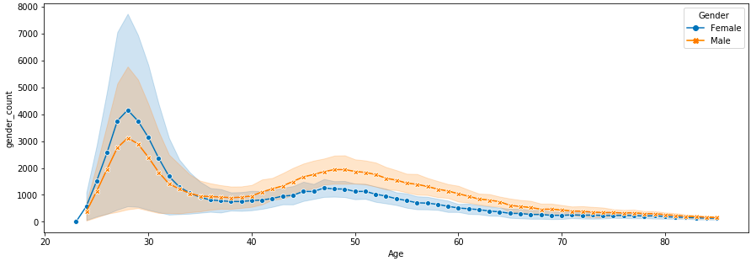
Exploratory Data Analysis - Relation between Age and Is_Lead with respect to Gender
Compared to Male, Happy Customer Bank has Female customer base starting at an early age with more number of females in the Young age group of 23-33 years of age who are interested for credit cards. The overall trend for interest in credit card seems decreasing with Age. There seems a small hike in number of Male customers at Middle age group of 35-60 years of age. The Happy Customer Bank seems popular among Young age group in terms of credit card business.

Slide 10
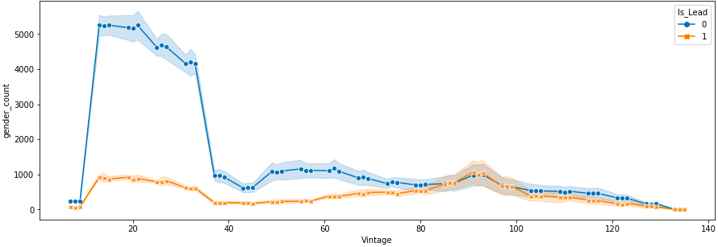
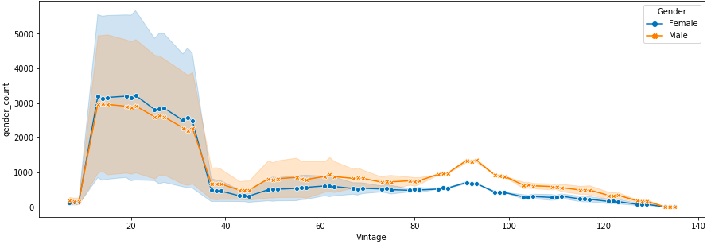
Exploratory Data Analysis - Relation between Vintage and Is_Lead with respect to Gender
Similar to Age feature lower the Vintage value greater is the interest shown in Credit Card. However, this may induce a risk. Financial Institutions rely on Vintage feature, for confidence in the business/individual as it indicates the track-record of the business/individual and commitment of the business/individual.
A suggestion would be to have detailed KYC before offering credit card.

Slide 11
Exploratory Data Analysis - Relation between Vintage and Is_Lead with respect to Gender
Similar to Age feature lower the Vintage value greater is the interest shown in Credit Card. However, this may induce a risk. Financial Institutions rely on Vintage feature, for confidence in the business/individual as it indicates the track-record of the business/individual and commitment of the business/individual.
A suggestion would be to have detailed KYC before offering credit card.

Slide 12
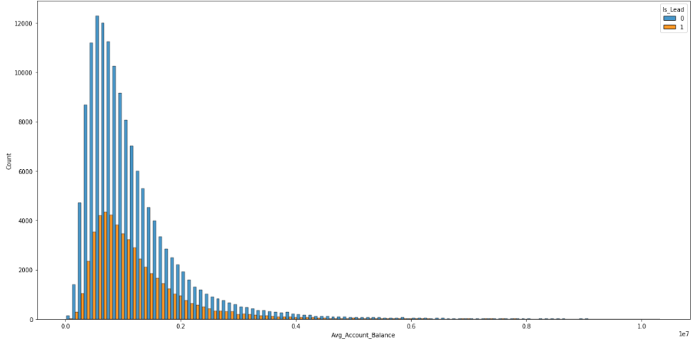
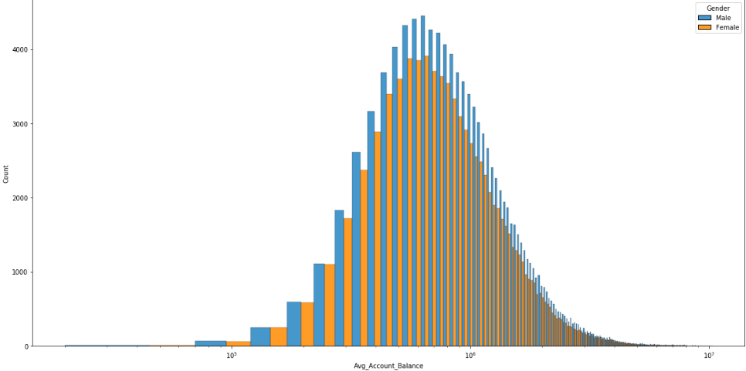
Exploratory Data Analysis - Relation between Average Account balance and Is_Lead with respect to Gender
From above data we could see most of the customers are maintaining a good average balance, however when it comes to showing interest in Credit Cards, the number seems low.
A suggestion would be to put efforts to tap the potential basis Average Account Balance as feature by reaching out to such customers.

Slide 13
Data processing Approach
From the data provided we could find that Credit_Product as a feature contains Null values. The approach is taken to fill out Null values with ‘Yes’ value in order to balance the data.
In order to convert Categorical data to Numeric data for model building, we have made use of both Label Encoding as well as One Hot Encoding techniques and verified the results. Label Encoding seems to be performing better in case training dataset.

Slide 14
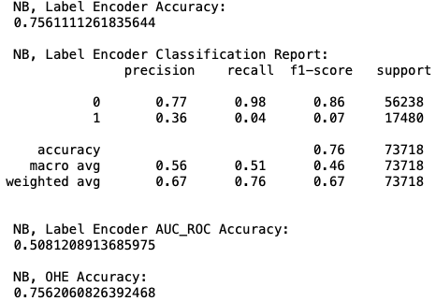
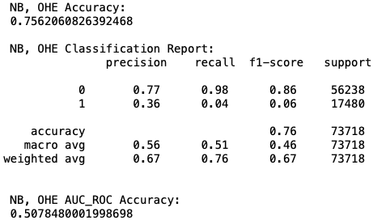
Training model with Naïve bayes
The training model with Naïve Bayes classification does not seem to give good results in terms of ROC_AUC score (for both Label Encoding as well as One Hot Encoding).

Slide 15
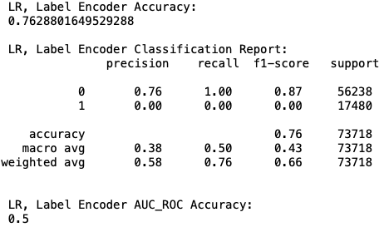
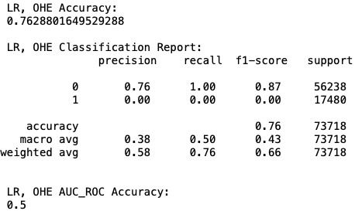
Training model with Logistic Regression
The training model with Logistic Regression classification does not seem to give good results in terms of ROC_AUC score (for Label Encoding as well as One Hot Encoding).

Slide 16
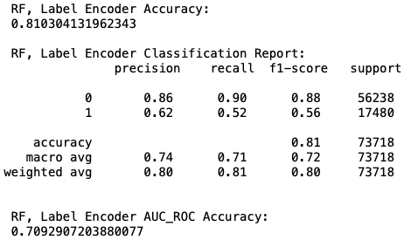
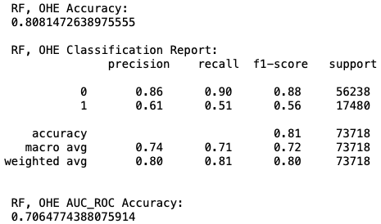
Training model with Random Forest
The training model with Random Forest classification does seem to give good results in terms of ROC_AUC score when compared with rest other two models. The score with Label Encoding is slightly better than for One Hot Encoding.

Slide 17
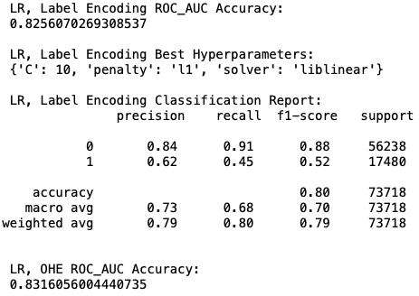
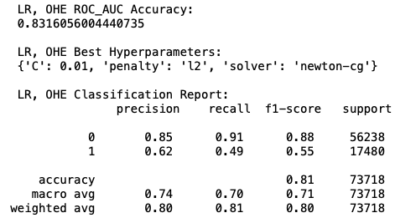
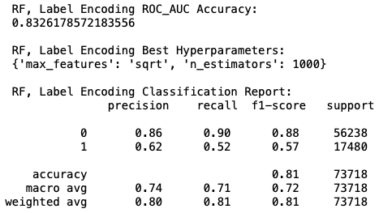
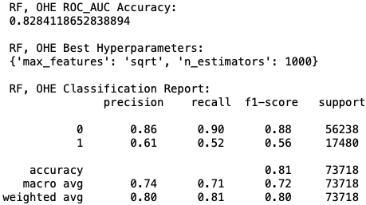
Training model with GridsearchCV
Using basic modeling parameters does not seem to give good results, hence in order to improvise on model results, we make use of hyper parameter tuning. The models considered are Logistic Regression and Random Forest classifiers.
With application of GRIDSEARCHCV we could see a great leap in the ROC_AUC score for models. Out of four different parameters tried, we see Random Forest Classifier with Label Encoding technique to give one of the best result so far.

